Slide 1
Direct Drive Hand Characterization
Advaith Sethuraman

Slide 2
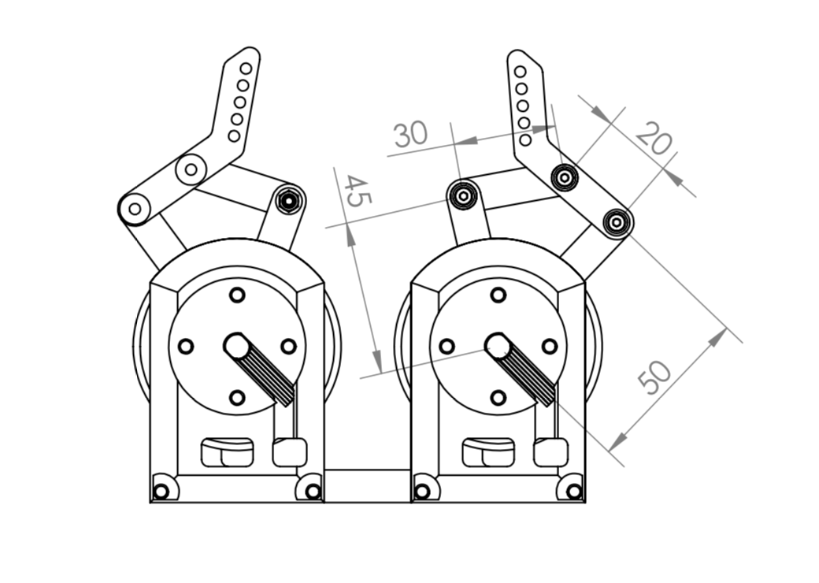
Goal
Construct a spring-damper system in x, y-axes for a 4-link direct drive arm

Slide 3
Plan
Characterize workspace
Singularity positions to avoid
Manipulability metrics
Work on embedded motor code to produce spring damper feedback system

Slide 4
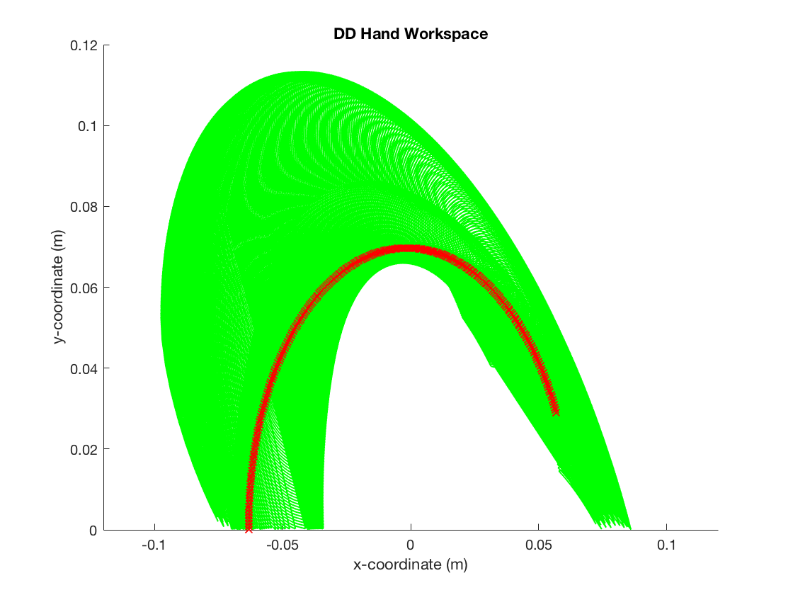
4-link Arm Workspace
Green – valid workspace coordinates
Red – Singularity positions

Slide 5
Finding Bounds of Workspace
Find points that maximize bounding-box area in cartesian space
Avoid singularities
Set these as joint limits in theta-space

Slide 6
Future Steps
Write PID controller to mirror a spring dampener system

